Slide 1

What are Services in
Angular?

Slide 2

What is service in angular?
In An Angular service can be thought of as a specialized tool that performs a specific function or set of functions, similar to how a specialized tool in the real world performs a specific task or set of tasks.
For example, a carpenter might use a specialized saw for cutting intricate shapes in wood, while an Angular service might be used to handle complex business logic or data manipulation in a web application.

Slide 3
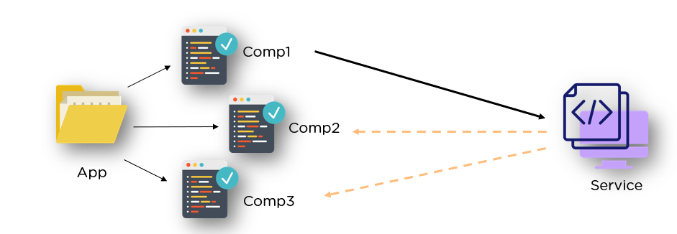
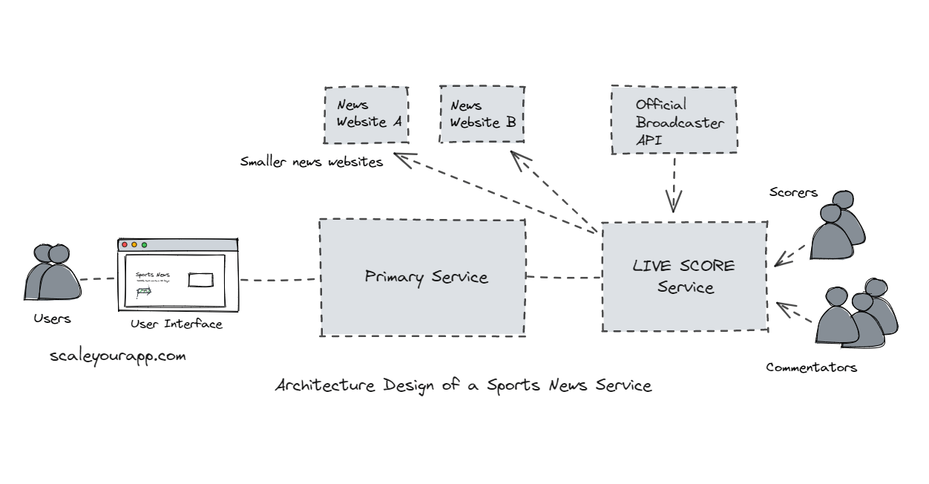
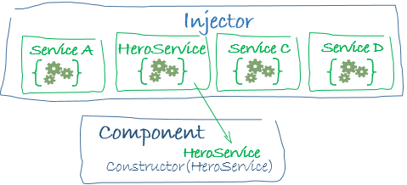

Slide 4
Example
Lets jump to VS code ☺

Slide 5
Angular services have the following characteristics
Reusability: Services in Angular are designed to be reusable across different components and modules of an application. This reduces code duplication and improves the maintainability of an application.
Dependency Injection: Angular services are often used with dependency injection, which allows components to access services without directly creating instances of them. This helps to decouple components from each other, making it easier to update and modify them.
4. Singleton: By default, Angular services are created as singletons, meaning that there is only one instance of a service throughout an application. This can improve performance and reduce memory usage.
5. Separation of Concerns: Services in Angular are designed to handle specific tasks or functions, such as retrieving data from a server or handling user authentication. This helps to keep code organized and makes it easier to maintain and debug an application.
6. Asynchronous operations: Services in Angular can be used to perform asynchronous operations, such as making HTTP requests to a server or handling long-running tasks in the background. This allows an application to remain responsive to user input and avoid blocking the UI.

